Slide 1
Random Forest
UIUC ECON 490: Applied Machine Learning in Economics

Slide 2
Tree-based Models
Pros
Best interpretative model
How humans make decisions
Low bias
Cons
(very) high variance
Initial conditions (training data) matters
Improvements
Bagging
Boosting
Not limited to trees-based models

Slide 3
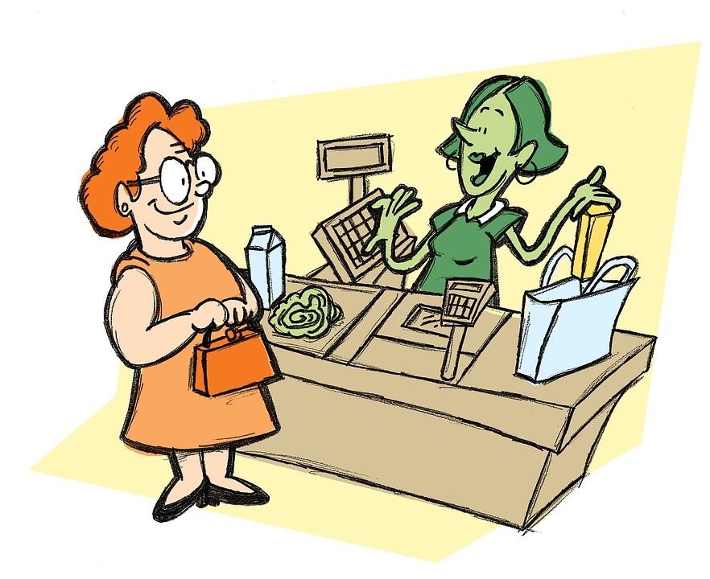
Bagging

Slide 4

Baggins

Slide 5
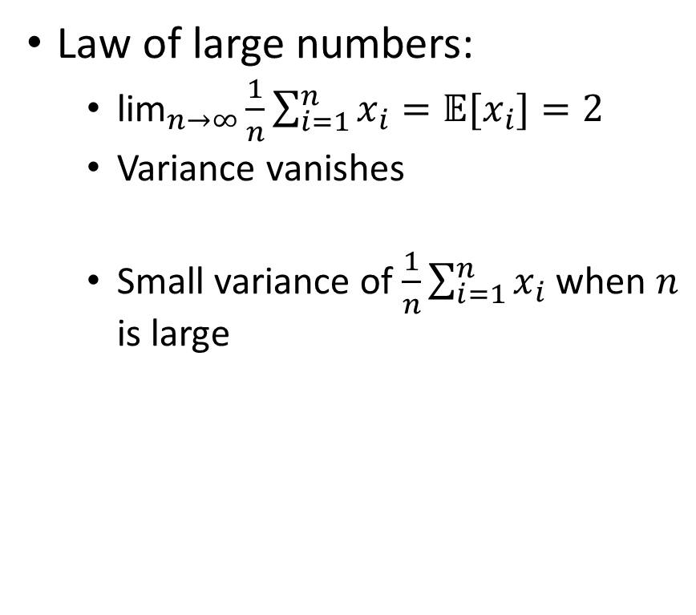
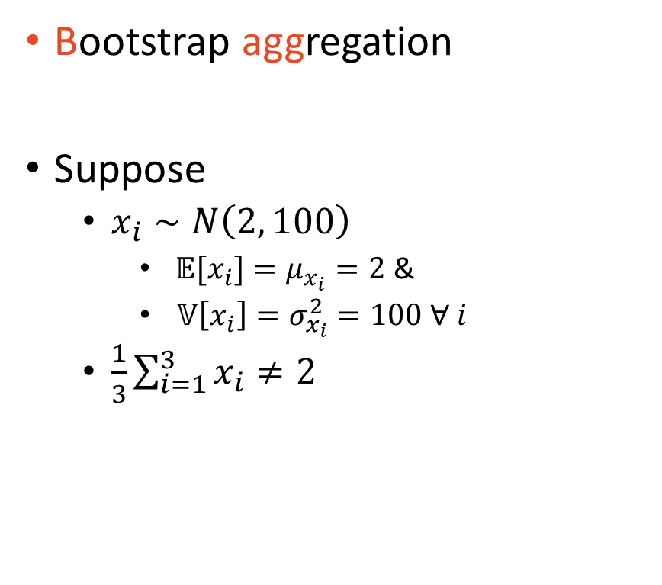
Bagging
Bootstrap aggregation
Suppose
$x_{i}∼N\left(2, 100\right)$
$𝔼[x_{i}]=μ_{x_{i}}=2$ &
$𝕍\left[x_{i}\right]=σ_{x_{i}}^{2}=100 ∀ i$
$\frac{1}{3}\sum_{i=1}^{3}{x_{i}}≠2$
Law of large numbers:
${\text{lim}}_{n→∞}\frac{1}{n}\sum_{i=1}^{n}{x_{i}}=𝔼[x_{i}]=2$
Variance vanishes
Small variance of $\frac{1}{n}\sum_{i=1}^{n}{x_{i}}$ when $n$ is large

Slide 6

Bagging – In practice
For $B$ iterations
Bootstrap sample
Fit model
Average $B$ models
Deeper trees have higher variance
Fit a few hundred or thousand
No pruning
Average
Reduces variance and low bias is unaffected
Classification – Majority voting

Slide 7
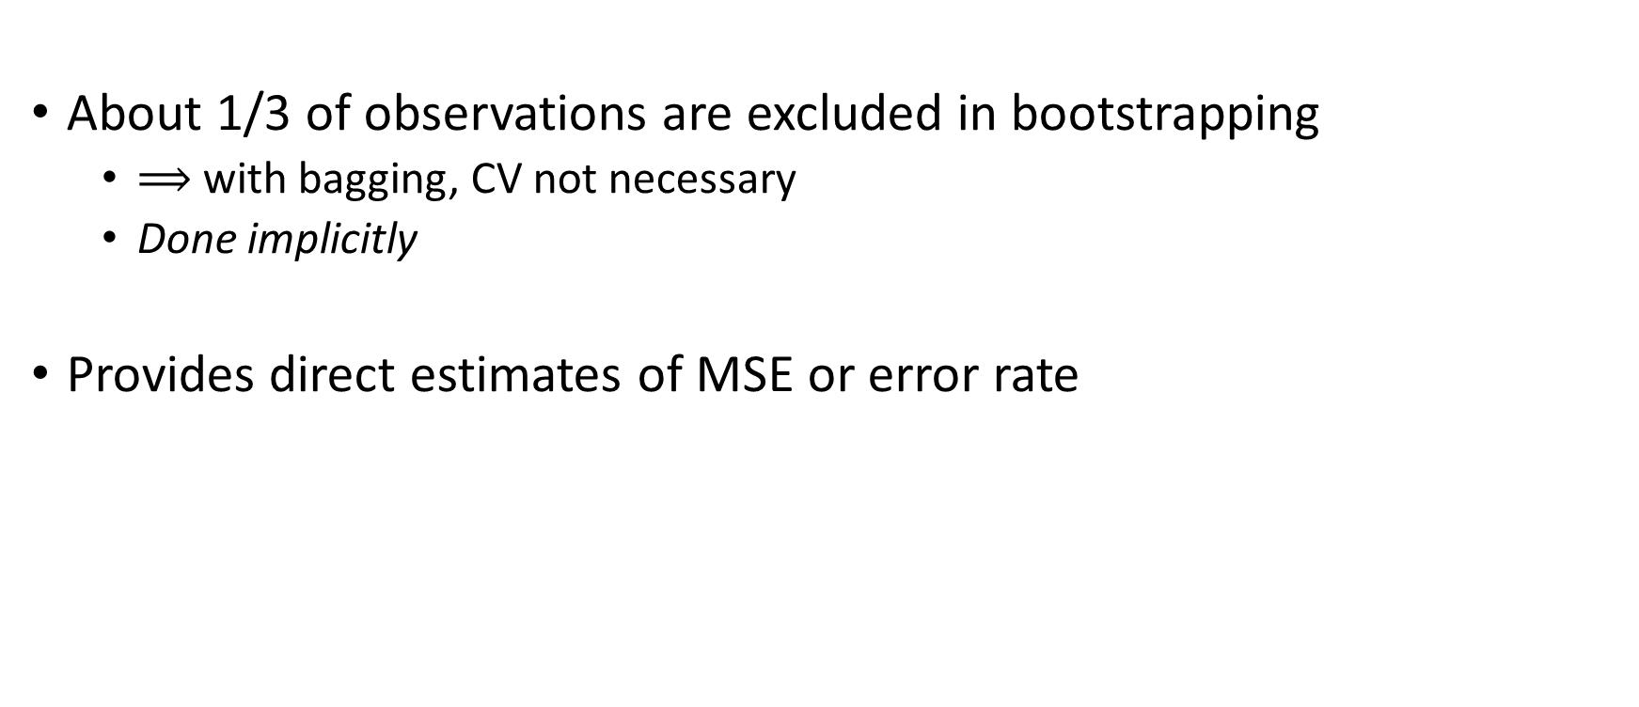
Out of Bag (OOB) error rate
About 1/3 of observations are excluded in bootstrapping
$⟹$ with bagging, CV not necessary
Done implicitly
Provides direct estimates of MSE or error rate

Slide 8
Bagged Trees
Trees have the cleanest interpretation of any model we will cover
Most similar to how humans make decisions
But not very accurate
Bagged trees
Significantly more accurate
Removes the interpretation from trees (what we like)

Slide 9
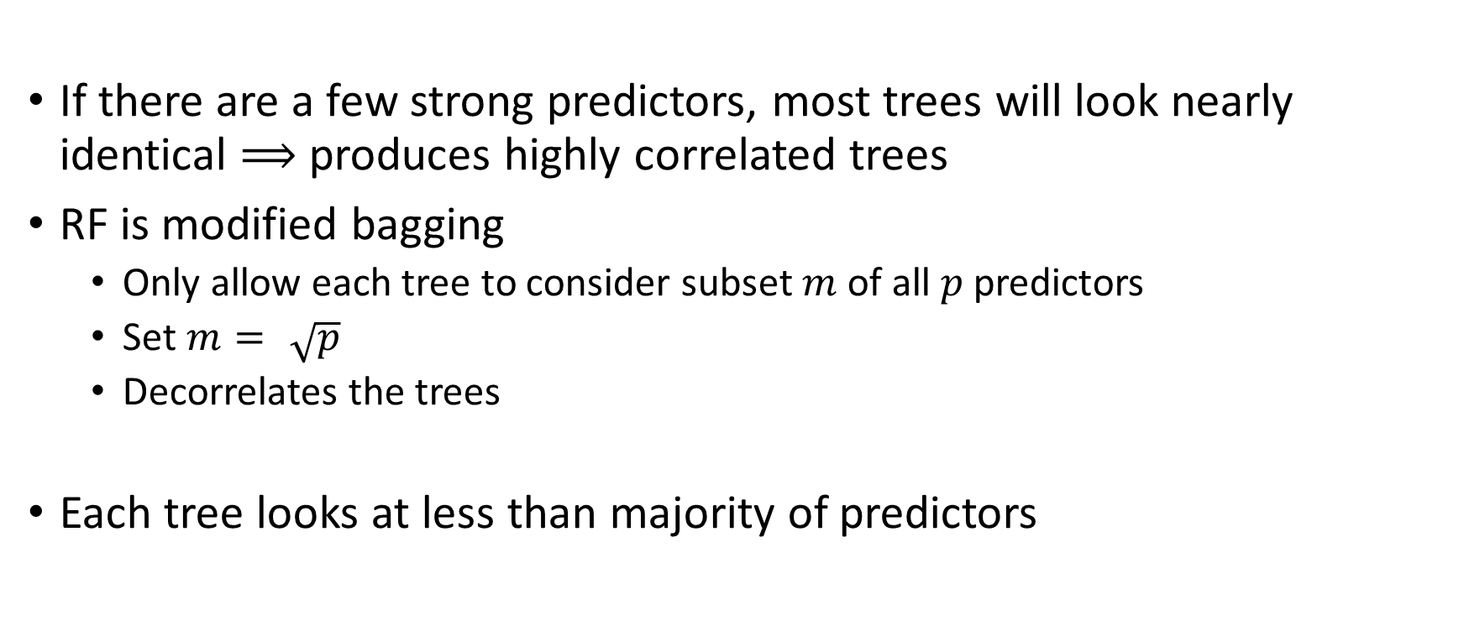
Random Forest
If there are a few strong predictors, most trees will look nearly identical $⟹$ produces highly correlated trees
RF is modified bagging
Only allow each tree to consider subset $m$ of all $p$ predictors
Set $m=\sqrt{p}$
Decorrelates the trees
Each tree looks at less than majority of predictors

Slide 10
To Do
Read
Boosting Ch 8.2.4
Complete
Lab 8.3.1, 8.3.2, 8.3.3

